Slide 1

Go, change the world
RV College of
Engineering
Tree Species Classification using Botanical Features
1RV20MC069
Poorvika GN
Under the Guidance
of
Dr K S Jasmine Syed Asim
Associate Professor Machine Learning Developer
Department of MCA Inventeron
RV College of Engineering
Date Department of MCA, RVCE 1/14

Slide 2

Go, change the world
RV College of
Engineering
Agenda
Introduction and Objectives of the Project
Changes suggested in Phase II and Incorporation
Implementation
Testing
Results and Conclusion
Outcomes of the Project
References

Slide 3
Go, change the world
RV College of
Engineering
Introduction
  Problem Definition
The number of plant species are extremely huge, It is estimated that there are some three trillion mature trees and roughly 73,300 tree species in our world
Hence, it is impossible and not practical for a botanist or an expert, to be able to identify and classify all the species
In addition, some plant species may have high similarity between each other, taking a long time to differentiate them
Hence, there is a need to develop an automated or computerized system to identify and classify plants/trees
  Domain of the project
  The domain will be working is in the Agriculture Sector

Slide 4
Go, change the world
FF
RV College of
Engineering
Implementation
Module Name :Training
Purpose : To train the ML model using input dataset
Input : Data from the dataset
Function: Trains the model
Output : Model will be ready to test

Slide 5
Go, change the world
RV College of
Engineering
Implementation
Module Name : Visualization
Purpose :Understand the data clearly and to find relationship among data.
Input : Data from the dataset
Function: visualizes data in graphical format
Output : Gives graphical representation of data

Slide 6
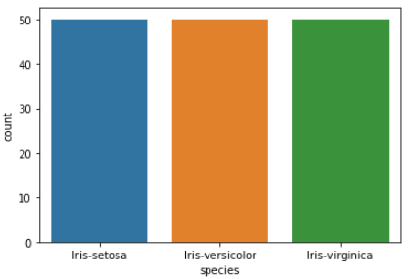
Go, change the world
RV College of
Engineering
Implementation

Slide 7
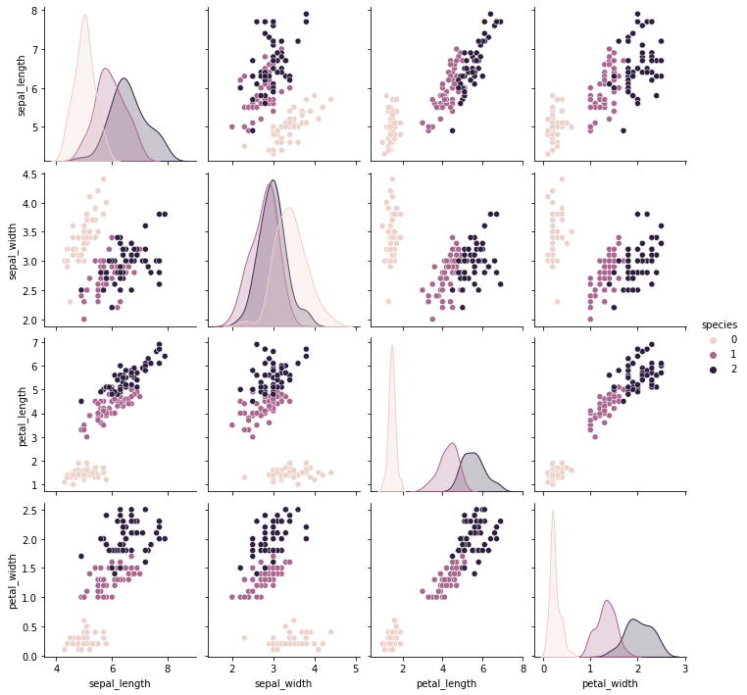
Go, change the world
RV College of
Engineering
Implementation
Fig. visualization of dataset

Slide 8
Go, change the world
RV College of
Engineering
Implementation
Module Name : Testing
Purpose : To test the y -trained model and the accuracy
Input : trained data from the model
Function: tests machine learning model
Output : Test and check the accuracy

Slide 9
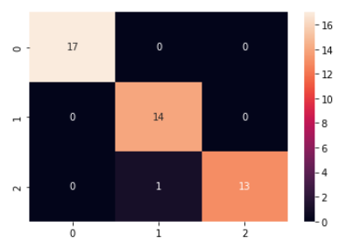
Go, change the world
RV College of
Engineering
Implementation
Fig. Confusion matrix

Slide 10
Go, change the world
RV College of
Engineering
Implementation
Module Name : Validation
Purpose : To validate the working of ML model
Input : Data that need to be validated
Function: validates the data
Output : True or false

Slide 11
Go, change the world
RV College of
Engineering
Testing
Unit Testing
Tc_ID | Feature Tested | Sample Input | Actual Output | Expected Output | Output Results
1 | Number of Species | 0 | 5 | 5 | Pass
2 | Number of species | Any entries above 2 | null | null | Pass
3 | Decision tree model | Dataset with varying train and test split | 96% | 96% | Pass
 |  |  | 93% | 96% | Fail
4 | Random forest model | Dataset with varying train and test split | 98% | 98% | Pass
 |  |  | 87% | 98% | Fail

Slide 12
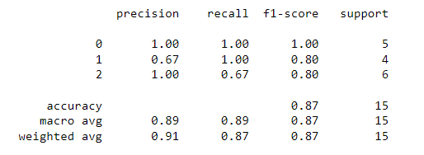
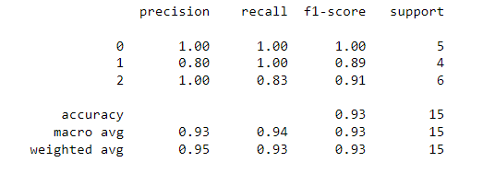
Fig . Decision Tree model
Fig . Random Forest model

Slide 13
Go, change the world
RV College of
Engineering
Testing
System Testing
Tc_ID | Feature Tested | Sample Input | Expected Output | Output Results
1 | Entire System | Dataset of Species | Classification of species | Pass

Slide 14
Go, change the world
RV College of
Engineering
Result and Conclusion
The proposed system describes how classification of tree species are useful to agriculture sector and forest department
The accuracy of the model is best compared to other model using different classification algorithms
The proposed model can also classify other species say birds ,fishes etc
Model helps in agriculture field that to in plant nursery which separates the tray of different plant and place them in specified designation with the automated system

Slide 15
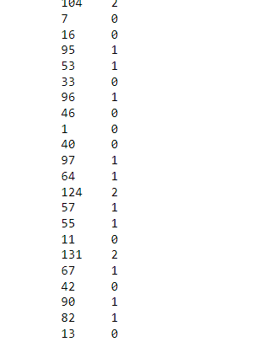
Go, change the world
RV College of
Engineering
Screen shots of Result
Fig.Model prediction after training

Slide 16
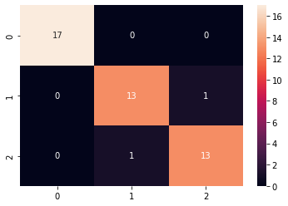
Go, change the world
RV College of
Engineering
Screen shots of Result
Fig. Confusion matrix of Decision tree model

Slide 17
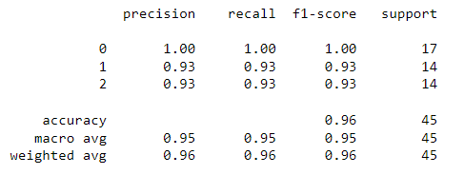
Go, change the world
RV College of
Engineering
Screen shots of Result
Fig. results of Decision tree model

Slide 18
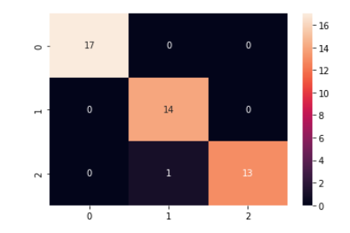
Go, change the world
RV College of
Engineering
Screen shots of Result
Fig. Confusion matrix of Random forest model

Slide 19
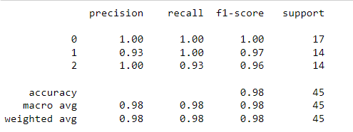
Go, change the world
RV College of
Engineering
Screen shots of Result
Fig. Results of Random forest model

Slide 20
Outcomes
Able to work on different machine learning algorithms such as Decision tree and Random forest
Able to build a highly accurate model that could classify the model
Added some new data to the dataset so that to improve the accuracy of the model 87% to 98%
Able to evaluate and validate the model to get the better performance

Slide 21
Go, change the world
RV College of
Engineering
References
Lim, Joongbin, Kyoung-Min Kim, and Ri Jin. "Tree species classification using hyperion and sentinel-2 data with machine learning in South Korea and China." ISPRS International Journal of Geo-Information 8.3 (2019): 150.
Marrs, Julia, and Wenge Ni-Meister. "Machine learning techniques for tree species classification using co-registered LiDAR and hyperspectral data." Remote Sensing 11.7 (2019): 819.
Hartling, Sean, Vasit Sagan, and Maitiniyazi Maimaitijiang. "Urban tree species classification using UAV-based multi-sensor data fusion and machine learning." GIScience & Remote Sensing 58.8 (2021): 1250-1275.
Franklin, S.E. and Ahmed, O.S., 2018. Deciduous tree species classification using object-based analysis and machine learning with unmanned aerial vehicle multispectral data. International Journal of Remote Sensing, 39(15-16), pp.5236-5245.

Slide 22
Go, change the world
RV College of
Engineering
References
Bambil, Deborah, et al. "Plant species identification using color learning resources, shape, texture, through machine learning and artificial neural networks." Environment Systems and Decisions 40.4 (2020): 480-484.
Pearline, S. Anubha, and V. Sathiesh Kumar. "Performance analysis of real-time plant species recognition using bilateral network combined with machine learning classifier." Ecological Informatics 67 (2022): 101492.
Zahid, Adnan, et al. "Machine learning enabled identification and real-time prediction of living plants’ stress using terahertz waves." Defence Technology (2022).
Poornappriya, T. S., and R. Gopinath. "Rice Plant Disease Identification using Artificial Intelligence Approaches." (2022).

